Slide 1




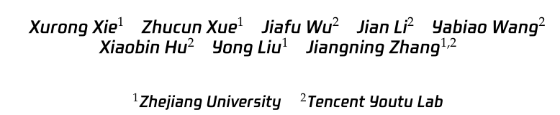





ATAI
Advanced Technique of Artificial Intelligence
ATAI
ChongqingUniversity _{AdvancedTechniqueof}
of Technology Artificial Intelligence
Chongqing University of Technology
Chongqing University ^{ATAI}
_{of Technology} Advanced Techniqueof
Artificial Intelligence
Chongqing University of Technology
Chongqing University of Technology
LLM-Oriented Token-Adaptive Knowledge Distillation
code:None
——AAAI’2026 (Oral)
Reported by Jinfei Chen
1

Slide 2
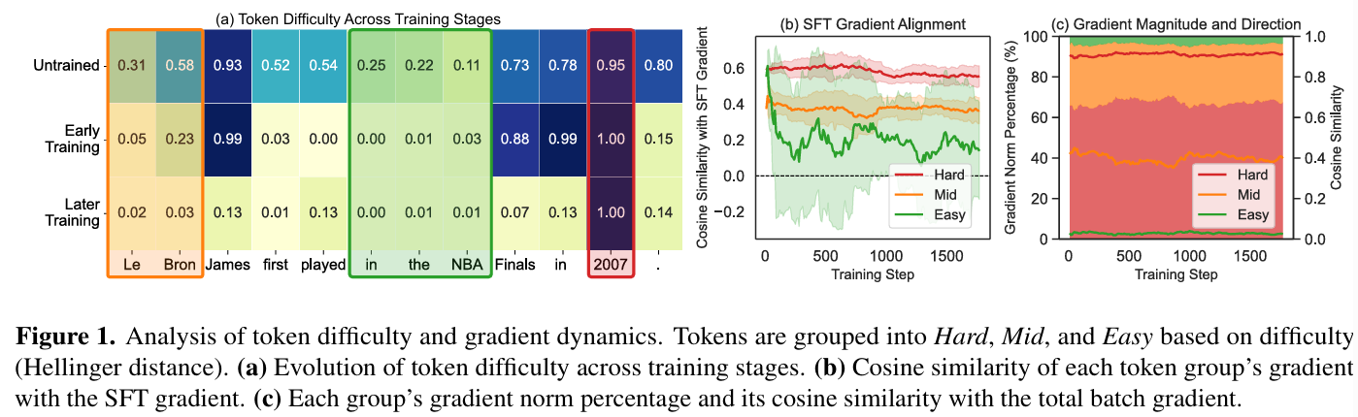
ATAI
Advanced Technique of
Artificial Intelligence
ATAI
ChongqingUniversity _{AdvancedTechniqueof}
of Technology Artificial Intelligence
Chongqing University of Technology
Motivation
1) Indiscriminate token treatment. Most methods treat all tokens indiscriminately, applying a uniform distillation objective across the entire sequence. This lack of differentiation is misaligned with the student’s real-time learning progress, resulting in suboptimal knowledge transfer and potentially introducing noise from tokens that are already well-mastered.

Slide 3
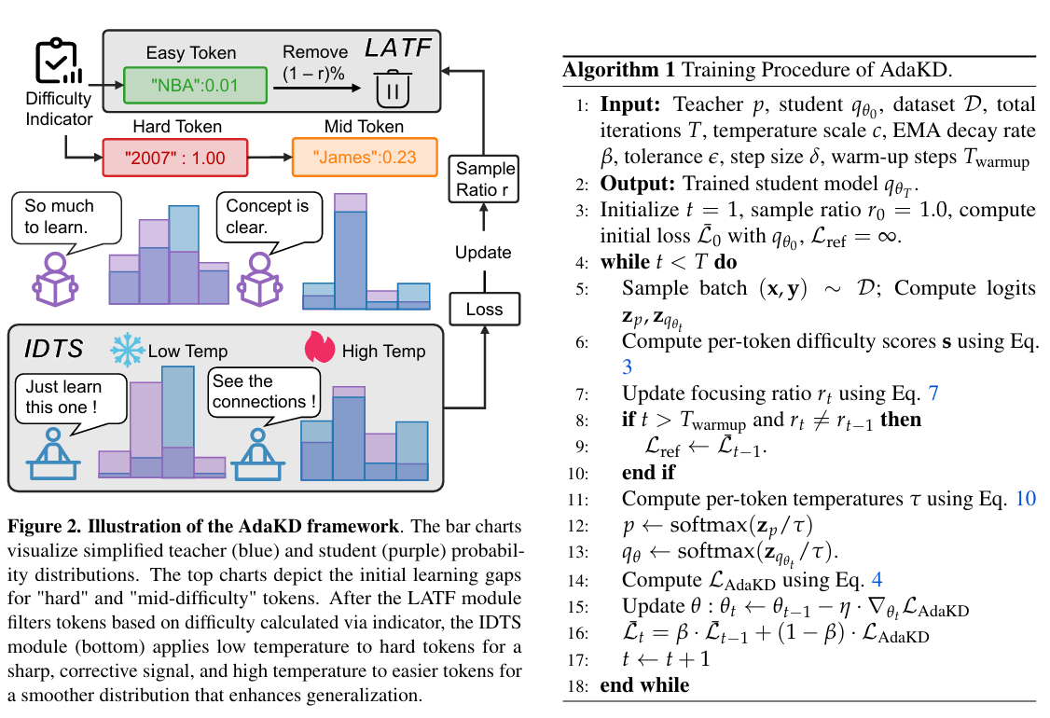
ATAI
Advanced Technique of
Artificial Intelligence
ATAI
ChongqingUniversity _{AdvancedTechniqueof}
of Technology Artificial Intelligence
Chongqing University of Technology
Overview

Slide 4
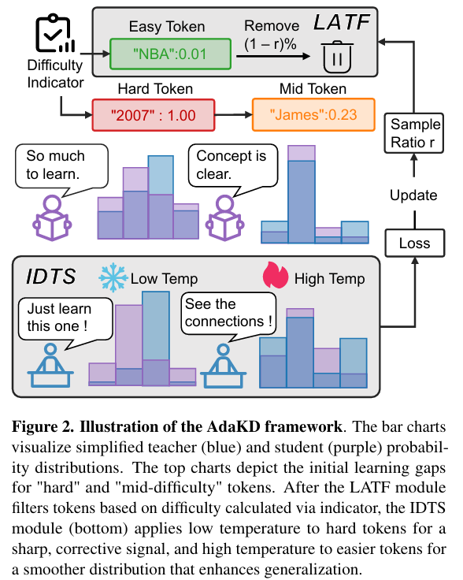
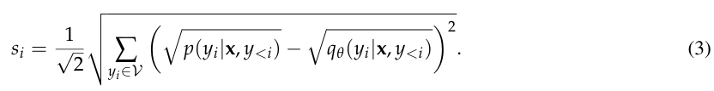

ATAI
Advanced Technique of
Artificial Intelligence
ATAI
ChongqingUniversity _{AdvancedTechniqueof}
of Technology Artificial Intelligence
Chongqing University of Technology
Method

Slide 5

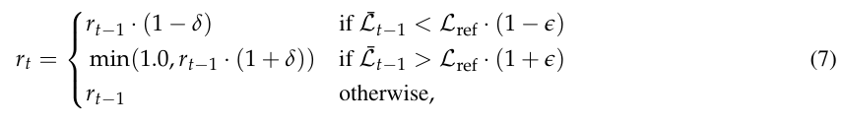
ATAI
Advanced Technique of
Artificial Intelligence
ATAI
ChongqingUniversity _{AdvancedTechniqueof}
of Technology Artificial Intelligence
Chongqing University of Technology
Method

Slide 6


ATAI
Advanced Technique of
Artificial Intelligence
ATAI
ChongqingUniversity _{AdvancedTechniqueof}
of Technology Artificial Intelligence
Chongqing University of Technology
Method

Slide 7

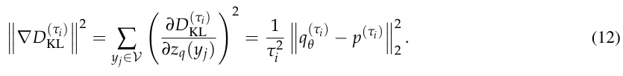


ATAI
Advanced Technique of
Artificial Intelligence
ATAI
ChongqingUniversity _{AdvancedTechniqueof}
of Technology Artificial Intelligence
Chongqing University of Technology
Method

Slide 8
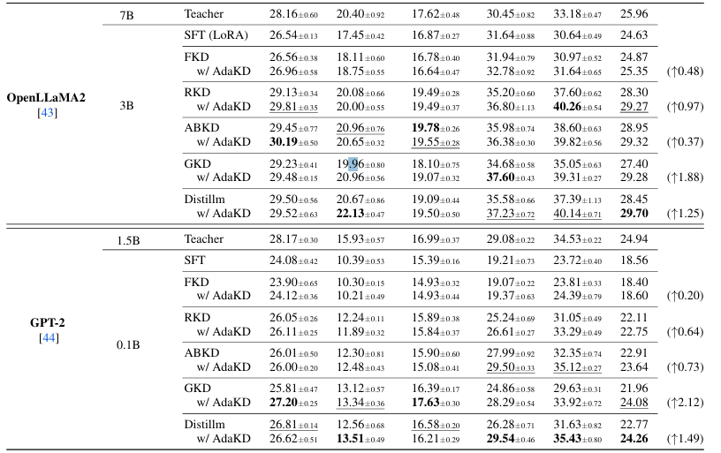
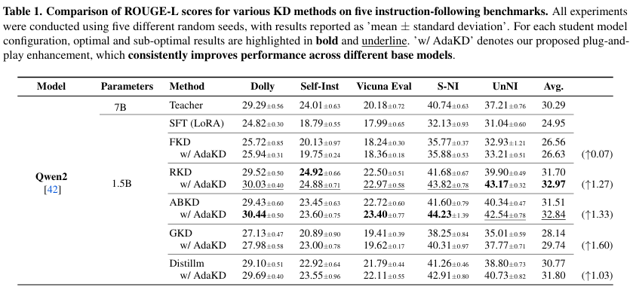
ATAI
Advanced Technique of
Artificial Intelligence
ATAI
ChongqingUniversity _{AdvancedTechniqueof}
of Technology Artificial Intelligence
Chongqing University of Technology
Experiments

Slide 9
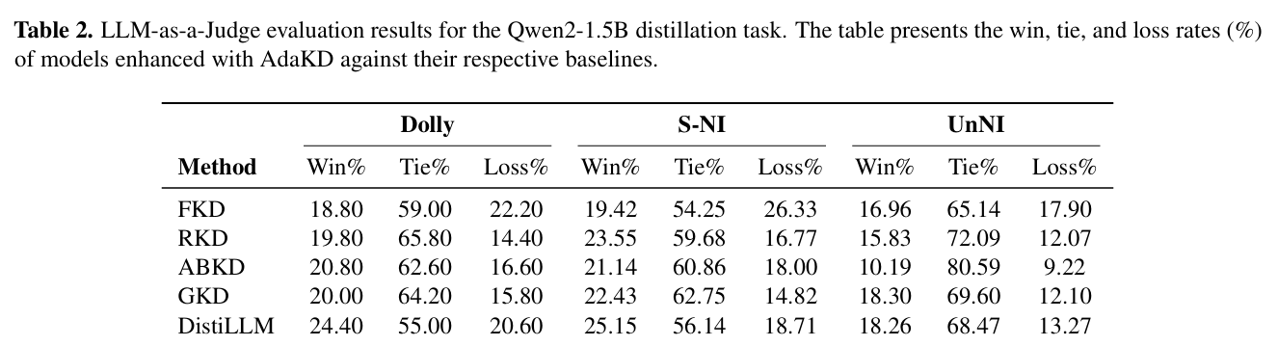
ATAI
Advanced Technique of
Artificial Intelligence
ATAI
ChongqingUniversity _{AdvancedTechniqueof}
of Technology Artificial Intelligence
Chongqing University of Technology
Experiments

Slide 10
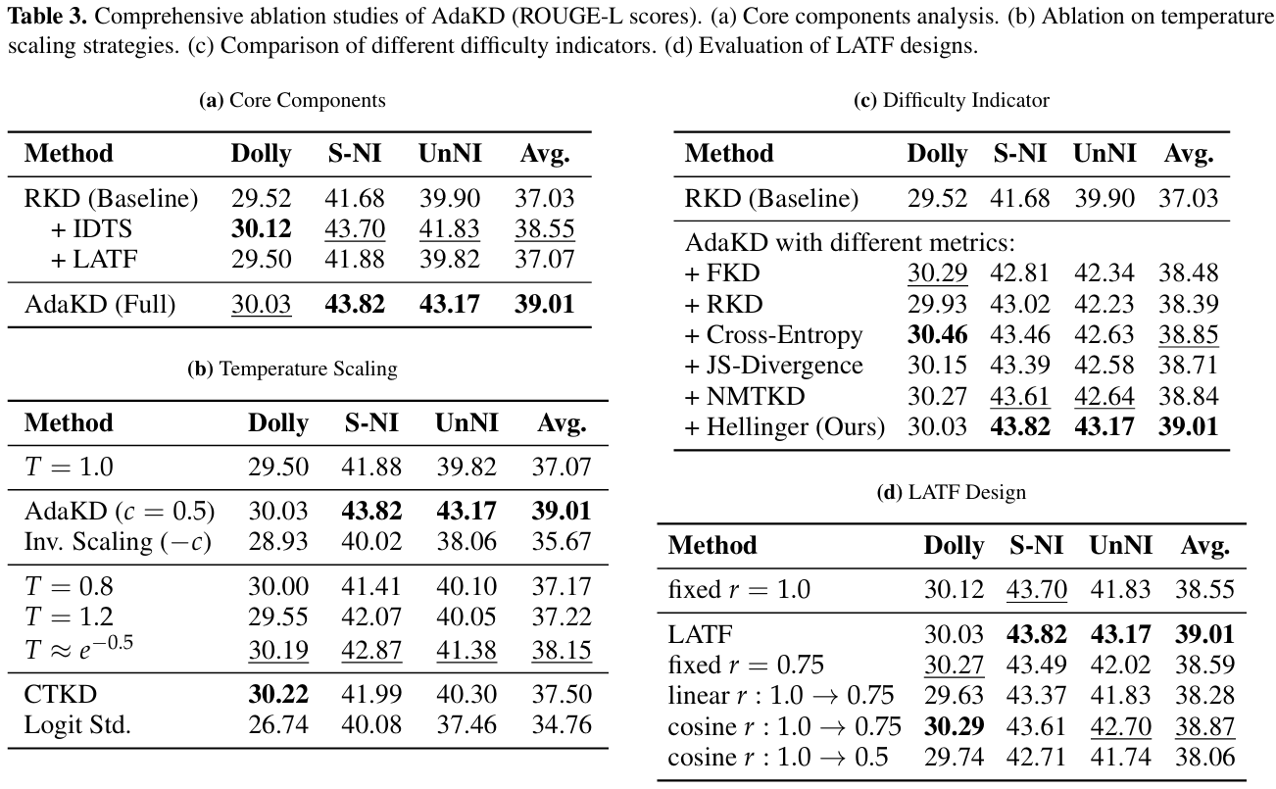
ATAI
Advanced Technique of
Artificial Intelligence
ATAI
ChongqingUniversity _{AdvancedTechniqueof}
of Technology Artificial Intelligence
Chongqing University of Technology
Experiments

Slide 11
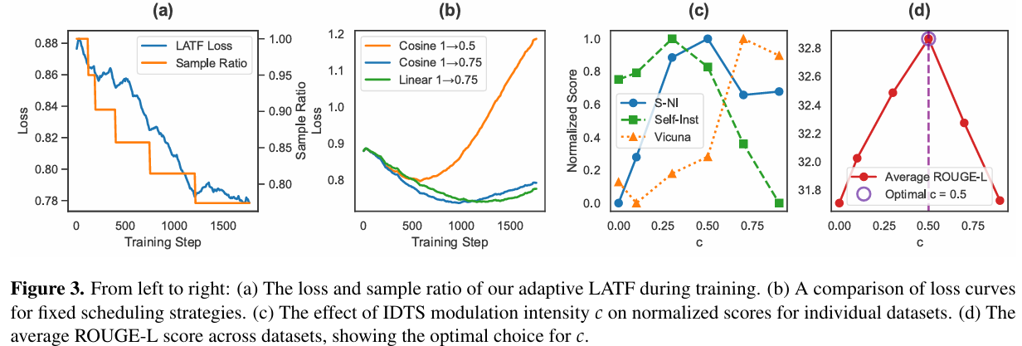
ATAI
Advanced Technique of
Artificial Intelligence
ATAI
ChongqingUniversity _{AdvancedTechniqueof}
of Technology Artificial Intelligence
Chongqing University of Technology
Experiments

Slide 12
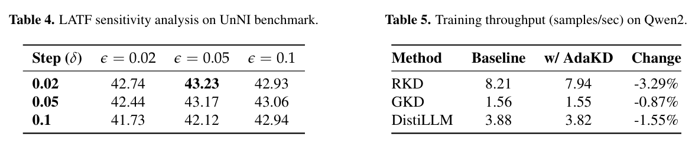
ATAI
Advanced Technique of
Artificial Intelligence
ATAI
ChongqingUniversity _{AdvancedTechniqueof}
of Technology Artificial Intelligence
Chongqing University of Technology
Experiments

Slide 13
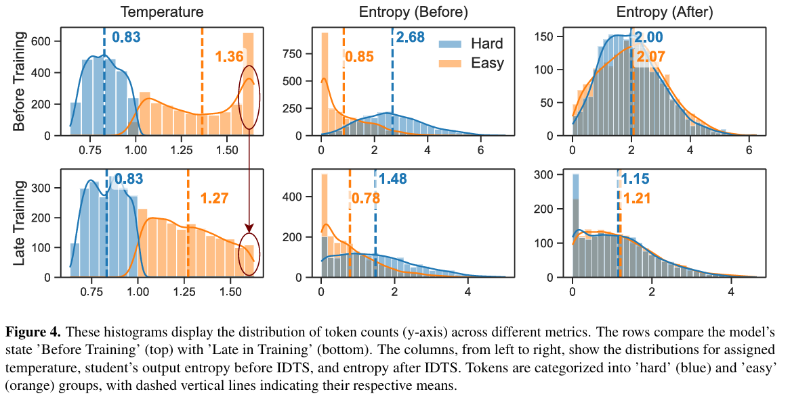
ATAI
Advanced Technique of
Artificial Intelligence
ATAI
ChongqingUniversity _{AdvancedTechniqueof}
of Technology Artificial Intelligence
Chongqing University of Technology
Experiments

Slide 14


ATAI
Advanced Technique of
Artificial Intelligence
ATAI
ChongqingUniversity _{AdvancedTechniqueof}
of Technology Artificial Intelligence
Chongqing University of Technology
Thanks!

